Slide 1

The Study-Gym
Capstone Project – The Battle of Neighborhood
Zheng Jiahui May 2020

Slide 2
Introduction
The Client
A friend of mine wants to set up a private tuition center in Singapore, which would target at students of age 12-18 years old, who are currently studying O-Levels/A-Levels or IGCSE/IB syllabus at local schools in Singapore.
However, due to the fierce competition, she has come up with a new idea: she would like to open Study-Gyms , which is a combination of a study room and a gym, in which students from the school could study, get help from tutors, read books and do physical exercises.
Recently, she approached me, asking me to help her find out where she should open such business ventures.

Slide 3
Introduction
The Factors
Population, esp. population of teenagers who are 12-18 years old:
The larger the population of students, the larger the market, as more teenagers would need private tuition services;
Public transport networks e.g. metro/MRT/buses, etc. :
The well-developed public transport network enables students who live further sway to come to tuition center conveniently;
Number of Schools in the area:
Higher concentration of schools means a large amount of students available.
Number of existing Bookstores and Gyms:
Higher number means more intense competition

Slide 4
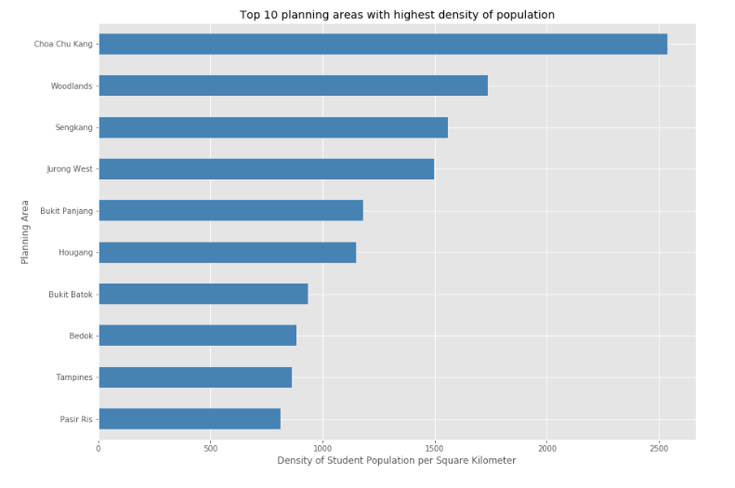
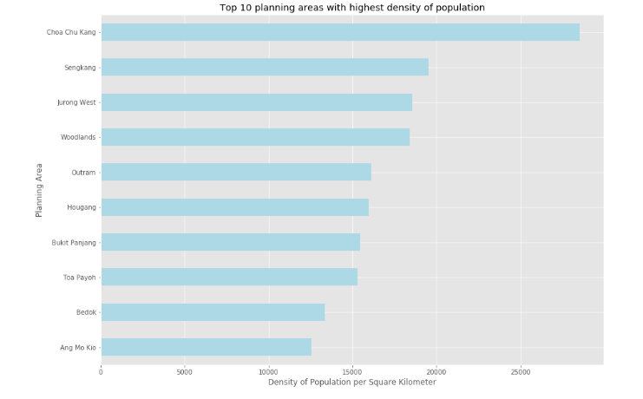
The top ten planning areas with the highest density of population of students attending Secondary Schools and Junior Colleges (or equivalent) are:
Choa Chu Kang
Woodlands
Sengkang
Jurong West
Bukit Panjang
Hougang
Bukit Batok
Betok
Tampines
Pasir Ris
The top ten planning areas with the highest density of population are:
Choa Chu Kang
Sengkang
Jurong West
Woodlands
Outram
Hougang
Bukit Panjang
Toa Payoh
Bedok
Ang Mo Kio

Slide 5
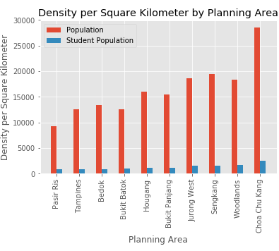
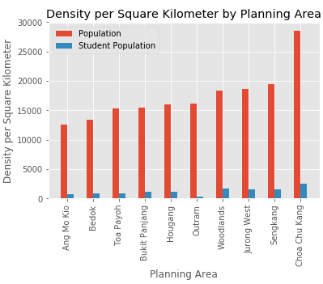
Analysis
From the above bar chart we could see that the planning areas with highest density of student population does not necessarily mean that they also have the highest population density.
The discrepancy may imply: for planning areas like Bukit Panjang, Jurong West, and Woodlands, the percentage of students in secondary education is higher. Whereas for planning areas like Toa Payoh, and Outram Park, the percentage of students in secondary education is lower.
A conjecture thus arises: does the mismatch the result of number of schools in the specific planning areas

Slide 6
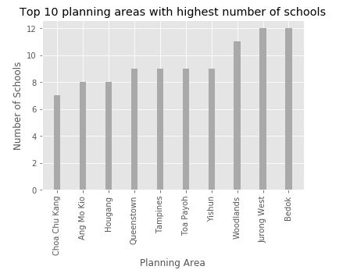
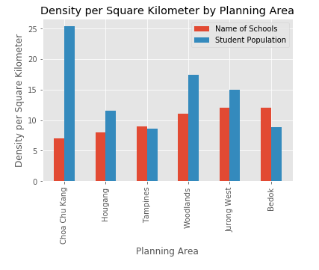
Top 10 Planning Areas with highest number of Secondary Schools/Junior Colleges(or equivalent)
The five planning areas with the highest density of Student (12 – 18 ys ) population and also the highest number of schools.

Slide 7
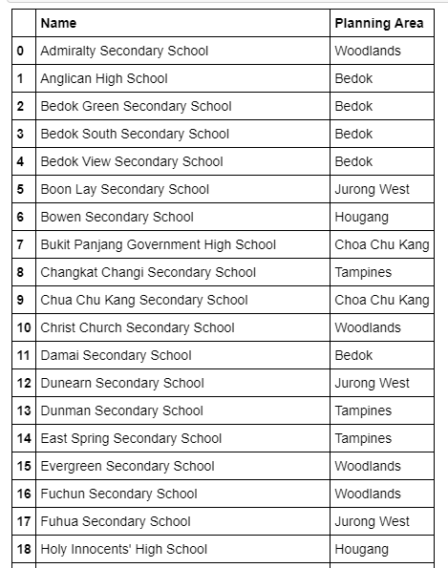
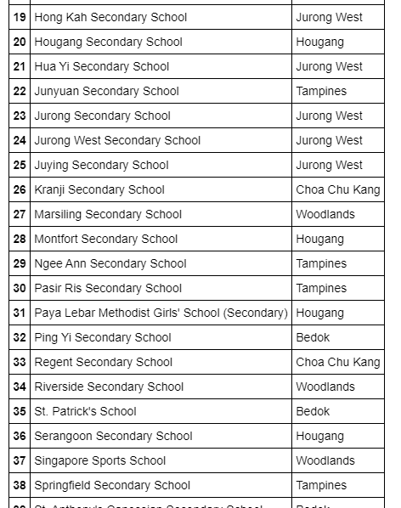
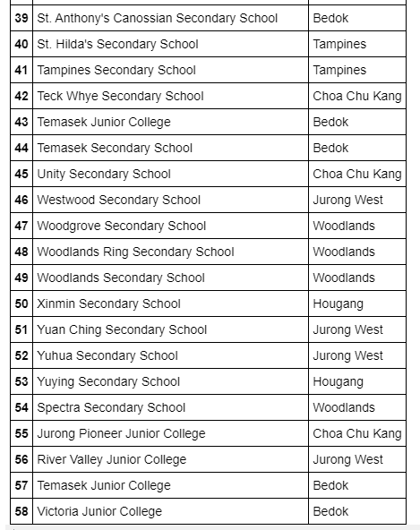
List of 59 Schools in the top 5 Planning Areas:
Choa Chu Kang, Hougang, Tampines, Woodlands, Jurong West and Bedok

Slide 8
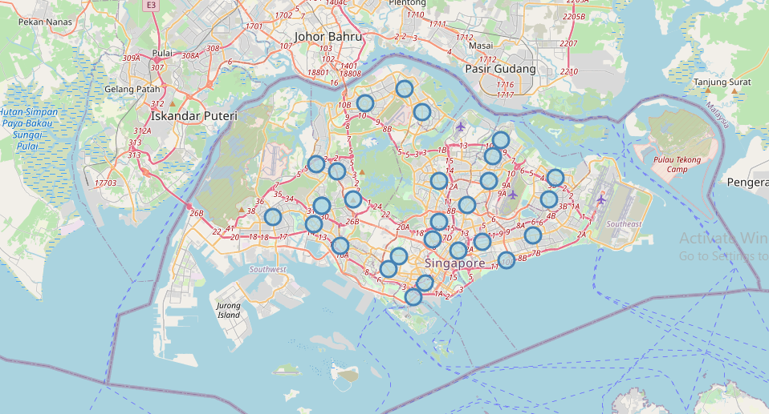
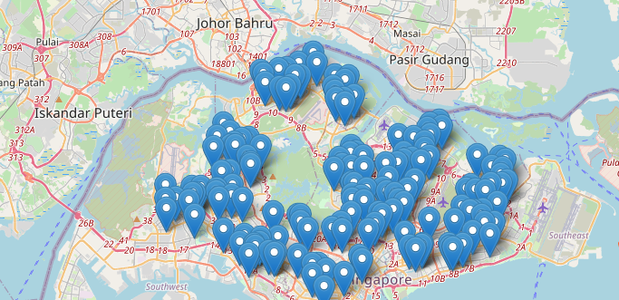
Secondary Schools and Junior Colleges (or equivalent) in Singapore
Singapore’s 27 Planning Areas with sizable number of Students.

Slide 9
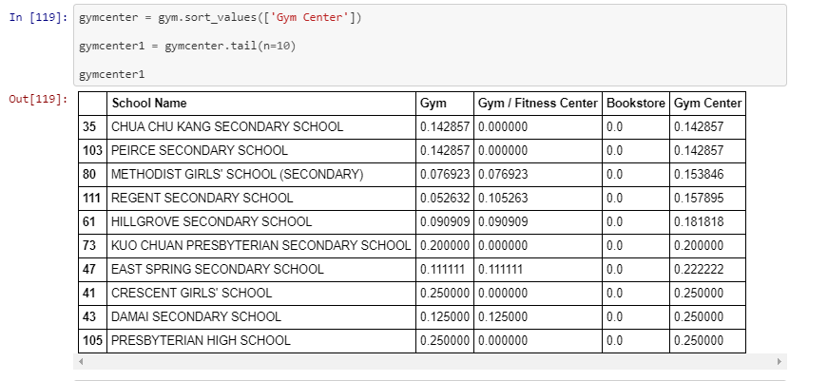
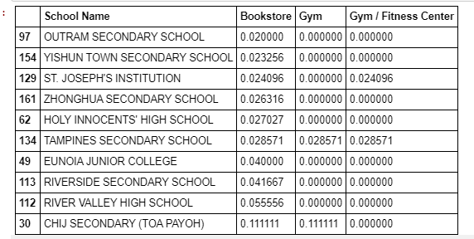
Ranked by Gym Centers
Ranked by Bookstores

Slide 10
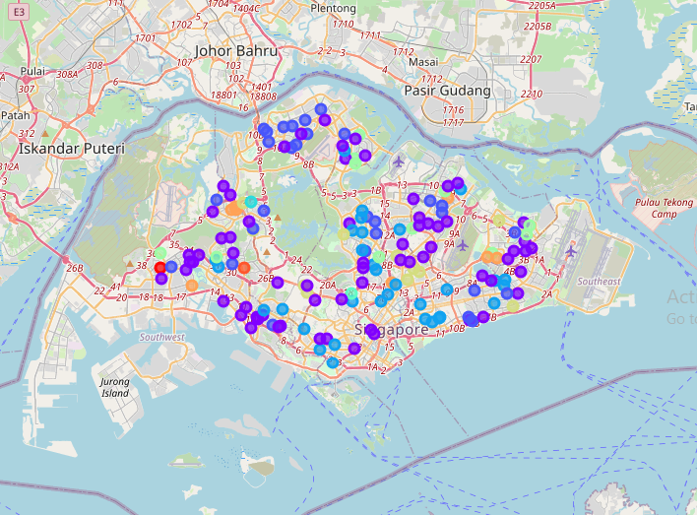
The Ten Clusters

Slide 11
Conclusion
According to the research, I would say my friend has come up with a quite interesting idea by combing study room/tuition with gyms
The one hot encoding shows that the neighborhoods of schools with the highest frequency of gyms would have low frequency of bookstores, which implies that a study gym would most likely to fill in an empty space.
So I would suggest my friend to open this Study Gym near the 45 schools.
However, my research is still not so refined yet; new insights would be generated with further research.

Slide 12
Dicussion and Improvement
The methodology could be further improved in the following ways.
1) The listed 59 schools should have been used for venues and one hot encoding
2) The frequency of tuition centers should be used instead of bookstores
3) Density of population in Subzones should be used

